Slide 1
Turing Machines and Computability
Thomas Wennekers
University of Plymouth
Notes:
1

Slide 2
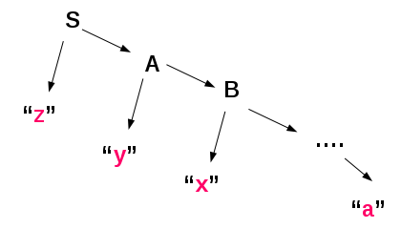
Regular Grammars
RegExps, DFAs, NFAs, and regular Grammars all generate or recognise exactly the Regular Languages
Notes:
2

Slide 3
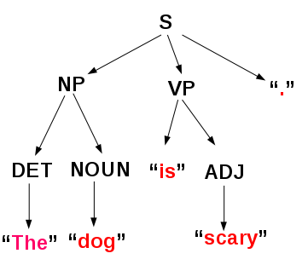
A simple Formal Grammar (Syntax tree is not degenerate -> can’t be regular)
S ::= NP VP “.” ;
NP ::= DET NOUN | NAME ;
DET ::= "a" | "an" | "the" ;
NOUN ::= "dog" | "house" | "pen" | "animal" ;
NAME ::= "John" | "Mary" | "Bob" ;
VP ::= "sleeps" | "sings" | "is" ADJ | “is” NP | "has" NP ;
ADJ ::= "large" | "red" | "scary" ;
3
Notes:
3

Slide 4
Context-Free Grammars and Languages
For “Context-Free Grammars” productions can have an arbitrary but finite sequence of variables on the right hand side of any rule.
A ::= B ‘c’ D ‘e’ ;
However, the left hand side must always be a single variable (without “context” nearby) → trees only
Notes:
4

Slide 5
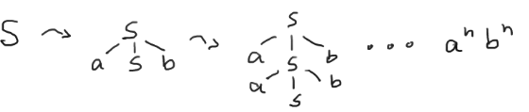
Context-Free Grammars Example 2 : a^{n}b^{n}
G = ( {S}, {a, b}, {S→aSb, S→ab}, S )
This Grammar generates { a^{n}b^{n} | n>0 }
Notes:
5

Slide 6
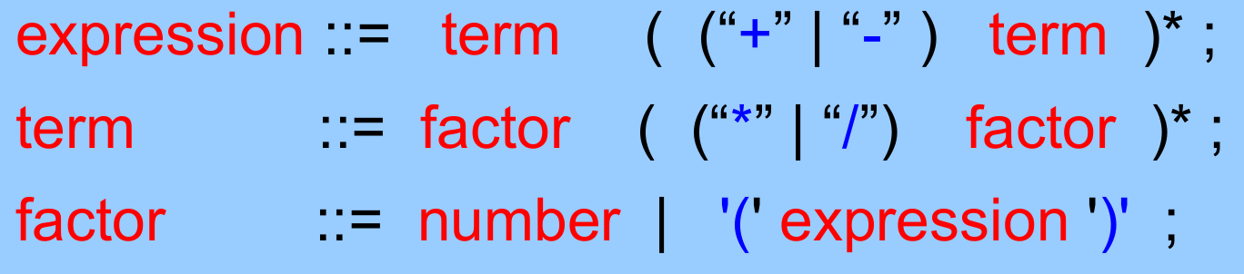
Context-Free Grammars Example 3 : C/C++/C#/Java ...
The syntax of many programming languages is formulated in a form equivalent to CFGs, e.g.
However, there are usually additional constraints, that are not context free (eg, Type systems and variable checking)
Notes:
6

Slide 7
Context-free Languages are processed
by Pushdown Automata [ (D|N)?PDA ]
Notes:
7

Slide 8
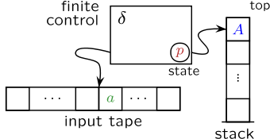
Pushdown Automaton
A pushdown automaton is basically a finite state automaton with an additional stack to store some information about the ongoing computation
Nothing else said, a PDA would use an NFA
Notes:
8

Slide 9
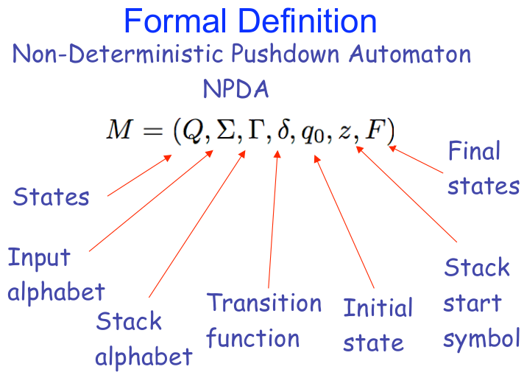
Notes:
9
Definition combines properties of the NFA and the stack; both join in the definition of delta
Stack start symbol == bottom of stack
different definitions of NPDAs can be found that are basically equivalent

Slide 10
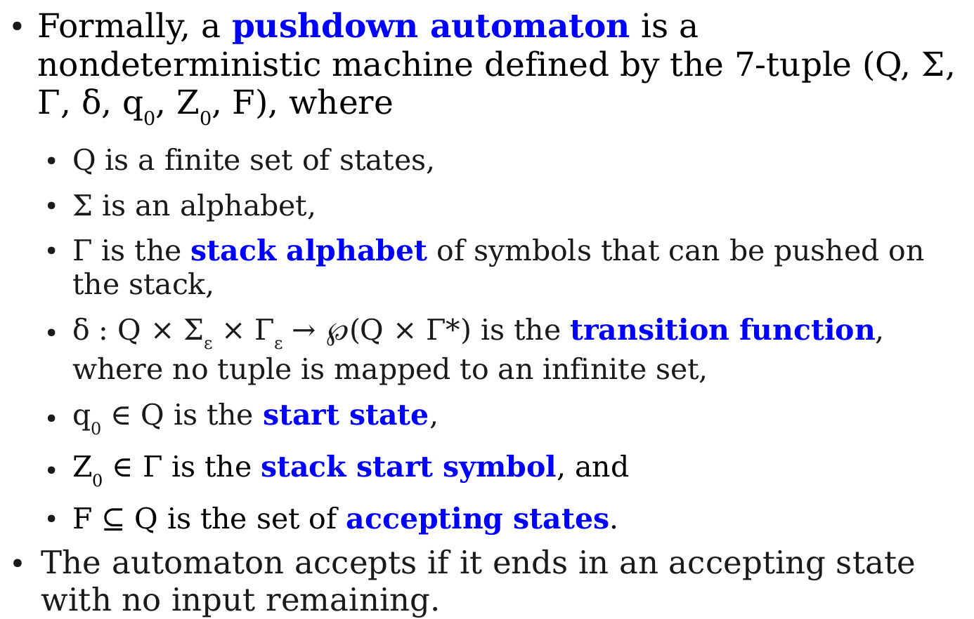
Formal Definition NPDA
next slide
Notes:
10
highlight delta , complicated , next slide
and the acceptance condition
others are possible, again basically equivalent

Slide 11
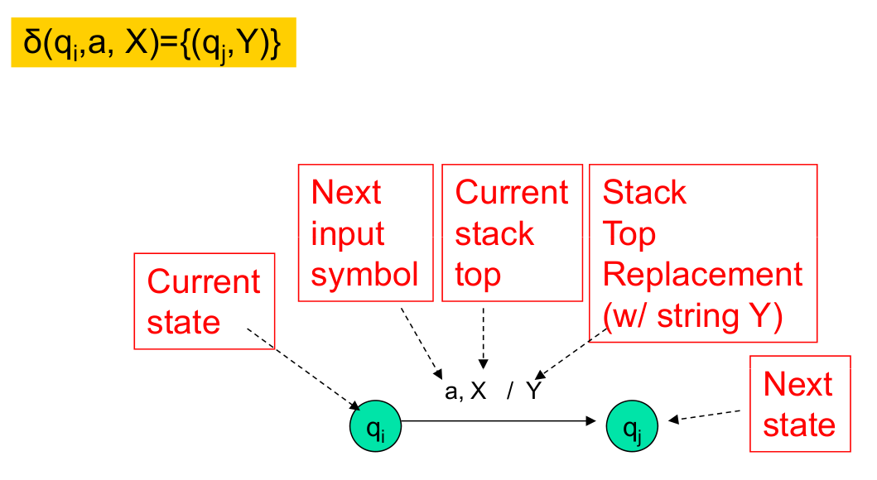
Transitions (not a simple table any more)
Non-determinism! {} possible, too
Notes:
11

Slide 12
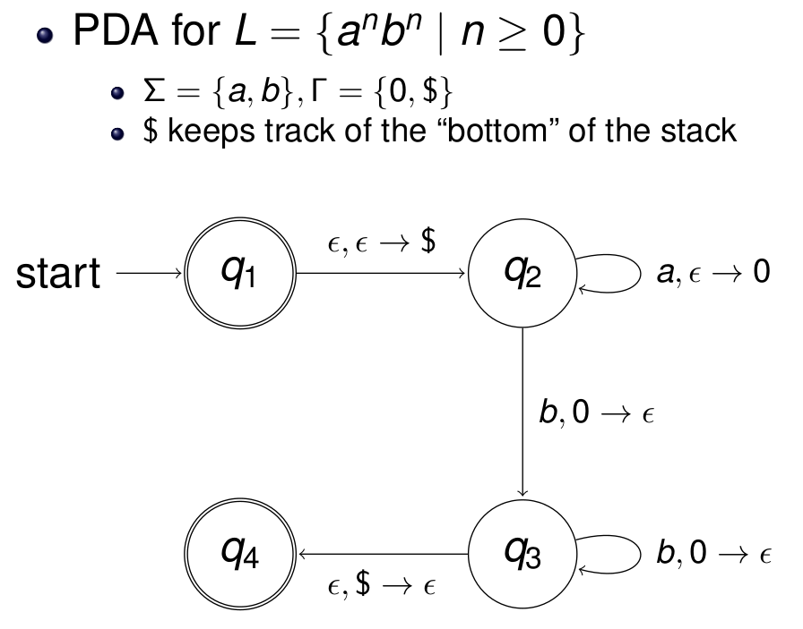
NPDA for a^{n}b^{n}
Notes:
12

Slide 13
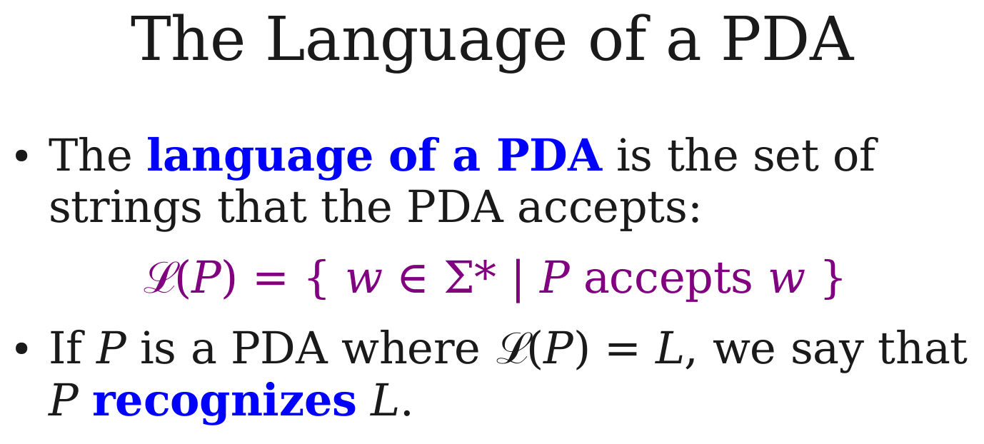
Non-Deterministic PDAs compute (i.e. recognise) exactly the context free languages.
Notes:
13

Slide 14
What does this mean for Computing?
A Program is a “word” of a CFL (C/C++/Java...)
A Parser uses a CFL to construct a syntax tree
A Compiler uses the syntax tree (plus context-sensitive constraints) to generate code for the Program that can be directly executed on a machine
Notes:
14

Slide 15
What does this mean for Computing?
A Program is a “word” of a CFL (C/C++/Java...)
A Parser uses a CFL to construct a syntax tree
A Compiler uses the syntax tree (plus context-sensitive constraints) to generate code for the Program that can be directly executed on a machine
Execution may use a (Deterministic) PDA …
… but usually machines that execute code are more complicated (Random Access Machine, von Neumann Architecture, Harvard Architecture … )
Notes:
15

Slide 16
Beyond Context-free Grammars
Chomsky Hierarchy of Languages
Notes:
16

Slide 17
Beyond Context-Free Grammars
In regular and context-free languages the left hand side of a production is always a single syntactic variable only
B → D c A
Notes:
17

Slide 18
Beyond Context-Free Grammars
In regular and context-free languages the left hand side of a production is always a single syntactic variable
More generally, this could be a string of terminals and variables, e.g.
a B c → D c A
this means B has to appear in a specific “context”
Notes:
18

Slide 19
Beyond Context-Free Grammars
In regular and context-free languages the left hand side of a production is always a single syntactic variable
More generally, this could be a string of terminals and variables, e.g.
a B c → D c A
this means B has to appear in a specific “context”
there could also be more variables on the left)
a B c D → D c A
Notes:
19

Slide 20
Beyond Context-Free Grammars
In regular and context-free languages the left hand side of a production is always a single syntactic variable
More generally, this could be a string of terminals and variables, e.g.
a B c → D c A
this means B has to appear in a specific “context”
This leads to Context-sensitive Languages if the strings never get shorter under any rule
Notes:
20

Slide 21
Beyond Context-Free Grammars
In regular and context-free languages the left hand side of a production is always a single syntactic variable
More generally, this could be a string of terminals and variables, e.g.
a B c → D c A
this means B has to appear in a specific “context”
This leads to Context-sensitive Languages if the strings never get shorter under any rule
.. and to Phrase-Structure Grammars if they can shrink, e.g.,
aBc → cD or even aBc →
Notes:
21

Slide 22
Context-Free vs Context-Sensitive
CF: variables are expanded independently of neighbours and expansions never get shorter
CS: Derivations can depend on neighbours; trees can grow, shrink, combine and even vanish
Notes:
22

Slide 23
Chomsky Hierarchy
phrase-structure
English?
context-sensitive
a^{n}b^{n}c^{n}
C/C++/Java
Syntax
context-free
a^{n}b^{n}
a^{n}b^{n}
regular
a*
Regular, context-free, context-sensitive and phrase-structure languages form a hierarchy by proper set inclusion, the Chomsky Hierarchy
Notes:
23

Slide 24
Example: {a^{n}b^{n}c^{n} | n>=1}
G = { V, Σ, P, S } a Grammar
V = { S, B, C } Variables
Σ = { a, b, c } Terminal Symbols
P = { S → aSBC, S→aBC, CB→BC, aB→ab,
bB→bb, bC→bc, cC→cc } Productions

Slide 25
Example: {a^{n}b^{n}c^{n} | n>=1}
G = { V, Σ, P, S } a Grammar
V = { S, B, C } Variables
Σ = { a, b, c } Terminal Symbols
P = { S → aSBC, S→aBC, CB→BC, aB→ab,
bB→bb, bC→bc, cC→cc } Productions
e.g.: S→aBC→abC→abc

Slide 26
Example: {a^{n}b^{n}c^{n} | n>=1}
G = { V, Σ, P, S } a Grammar
V = { S, B, C } Variables
Σ = { a, b, c } Terminal Symbols
P = { S → aSBC, S→aBC, CB→BC, aB→ab,
bB→bb, bC→bc, cC→cc } Productions
e.g.: S→aBC→abC→abc
S→aSBC→aaBCBC→aaBBCC→aabBCC
→aabbCC → aabbcC → aabbcc

Slide 27
Example: {a^{n}b^{n}c^{n} | n>=1}
G = { V, Σ, P, S } a Grammar
V = { S, B, C } Variables
Σ = { a, b, c } Terminal Symbols
P = { S → aSBC, S→aBC, CB→BC, aB→ab,
bB→bb, bC→bc, cC→cc } Productions
Conjecture (without proof)
L(G) = {a^{n}b^{n}c^{n} | n>=1}

Slide 28
Example: {a^{n}b^{n}c^{n} | n>=1}
G = { V, Σ, P, S } a Grammar
V = { S, B, C } Variables
Σ = { a, b, c } Terminal Symbols
P = { S → aSBC, S→aBC, CB→BC, aB→ab,
bB→bb, bC→bc, cC→cc } Productions
Conjecture (without proof)
L(G) = {a^{n}b^{n}c^{n} | n>=1}
This language is not context-free

Slide 29
L(G) = {a^{n}b^{n}c^{n} | n>=1} is not context-free
PDAs can do L₂(G) = {a^{n}b^{n} | n>=1}
This uses pushing and popping equal numbers of a stack symbol to/from the stack (see earlier)
After that we have lost the information about the value of n; there is nowhere to put it

Slide 30
L(G) = {a^{n}b^{n}c^{n} | n>=1} is not context-free
PDAs can do L₂(G) = {a^{n}b^{n} | n>=1}
This uses pushing and popping equal numbers of a stack symbol to/from the stack (see earlier)
After that we have lost the information about the value of n; there is nowhere to put it
We can also do L_{m}(G) = {a^{n}b^{n} c^{m}| n,m>=1}

Slide 31
L(G) = {a^{n}b^{n}c^{n} | n>=1} is not context-free
PDAs can do L₂(G) = {a^{n}b^{n} | n>=1}
This uses pushing and popping equal numbers of a stack symbol to/from the stack (see earlier)
After that we have lost the information about the value of n; there is nowhere to put it
We can also do L_{m}(G) = {a^{n}b^{n} c^{m}| n,m>=1}
a^{n}b^{n}c^{n} somehow needs more memory

Slide 32
L(G) = {a^{n}b^{n}c^{n} | n>=1} is not context-free
a^{n}b^{n}c^{n} somehow needs more memory
→ We could use two stacks

Slide 33
L(G) = {a^{n}b^{n}c^{n} | n>=1} is not context-free
a^{n}b^{n}c^{n} somehow needs more memory
→ We could use two stacks
For the a’s, push to stack 1
For the b’s pop from stack 1 and push to stack 2
For the c’s pop from stack 2

Slide 34
L(G) = {a^{n}b^{n}c^{n} | n>=1} is not context-free
a^{n}b^{n}c^{n} somehow needs more memory
→ We could use two stacks
For the a’s, push to stack 1
For the b’s pop from stack 1 and push to stack 2
For the c’s pop from stack 2
An NFA with 2 stacks is equivalent to a Turing Machine

Slide 35
L(G) = {a^{n}b^{n}c^{n} | n>=1} is not context-free
a^{n}b^{n}c^{n} somehow needs more memory
→ We could use two stacks
For the a’s, push to stack 1
For the b’s pop from stack 1 and push to stack 2
For the c’s pop from stack 2
Turing Machines are considered the most universal machines possible (at least on natural numbers)

Slide 36
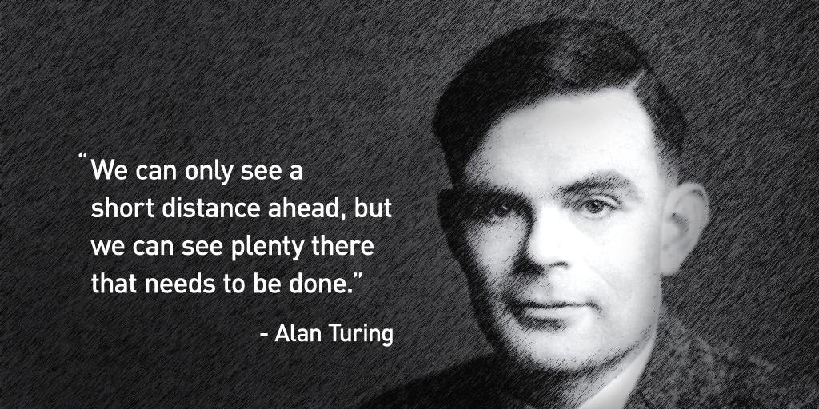
Turing Machines
Alan Turing, 23/6/1912-7/6/1954
Notes:
36

Slide 37
Turing Machine abstracts from Human Computations/Calculations
2D sheet of paper, pencil and eraser
Paper serves as a memory for intermediate results
Numbers are manipulated in a local context
Computations are done by a central control (in the brain/mind)
Initial problem formulated on the paper
Results of computations end up on the paper, too

Slide 38
Turing Machine Model
A central Control – basically an NFA
An infinite tape of discrete cells
A tape alphabet (symbols to write with)
A read/write head that can move left/right (or not)

Slide 39
Turing Machine Model
A central Control – basically an NFA
An infinite tape of discrete cells
A tape alphabet (symbols to write with)
A read/write head that can move left/right (or not)
A problem written on the tape
A stopping criterion

Slide 40
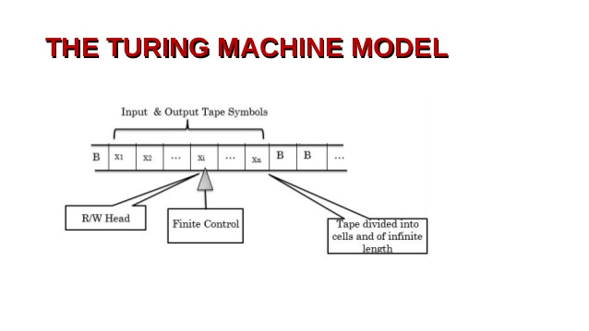

Slide 41
How the machine works:
Informally: in each step the machine can read a symbol, does a transition, writes back a symbol and then moves the head (or not).

Slide 42
How the machine works:
Informally: in each step the machine can read a symbol, does a transition, writes back a symbol and then moves the head (or not).
Epsilon transitions, readings and writings are possible → non-determinism (→machines can die)

Slide 43
How the machine works:
Informally: in each step the machine can read a symbol, does a transition, writes back a symbol and then moves the head (or not).
Epsilon transitions, readings and writings are possible → non-determinism (→machines can die)
A Turing machine halts immediately when it enters an accepting state and accepts whatever the original input string on the tape was (regardless of the final state of the tape and how much was read).

Slide 44
Formalisation of a Turing Machine

Slide 45
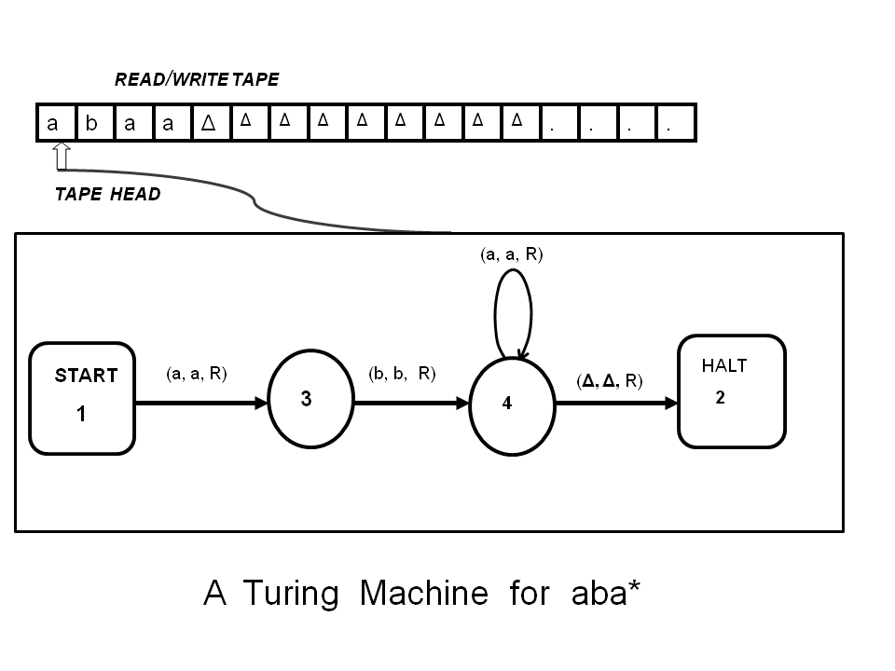

Slide 46
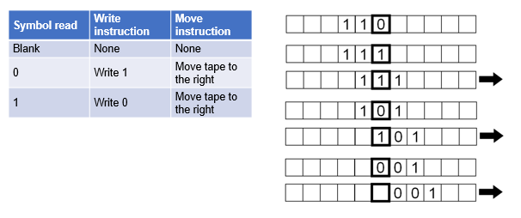
TM to compute Binary Inversion →TMs can compute functions
Note: The machine further needs state transitions and an accepting state when the input has been read

Slide 47
Are there more general Turing Machines ?
Higher dimensional tapes (eg 2-D ‘paper’) ?
Binary or other discrete number systems? Qbits ?
More than 1 tape ?
More than 1 head ?
Independent read/write heads ?
… all this does not make the model more powerful !

Slide 48
Is everything computable?
“everything” = every function over the natural numbers or every language

Slide 49
The Word Problem again
Given a word/string/program, is it an element of a certain formal language?
The word-problem is decidable for type 3, 2, and 1 languages (regular, context-free and context-sensitive)
This is quite obvious for type 3 and 2 grammars, the regular and context-free languages: the NFA always ends in some state for all inputs

Slide 50
The Word Problem again
Given a word/string/program, is it an element of a certain formal language?
The word-problem is decidable for type 3, 2, and 1 languages (regular, context-free and context-sensitive)
This is quite obvious for type 3 and 2 grammars, the regular and context-free languages: the NFA always ends in some state for all inputs
Correct syntax of (type-2) programs is decidable

Slide 51
The Type-1 Word Problem is also decidable (imagine the reverse application of rules)
Type-1 languages can be recognised by linearly bounded Turing Machines
Initially the word is written on the tape
The machine can find and apply matching rules
Replaced strings never get longer
Gaps can be filled by shifting
If one ends up with the Start symbol, the string can be accepted, otherwise rejected

Slide 52
Type-0 Languages are undecidable
Turing machines can be encoded in a binary code
word w (‘obvious’, because a PC can simulate them)

Slide 53
Type-0 Languages are undecidable
Turing machines can be encoded in a binary code
word w
A TM can therefore be called on a code of itself

Slide 54
Type-0 Languages are undecidable
Turing machines can be encoded in a binary code
word w
A TM can therefore be called on a code of itself
Call M_{w} a machine implementing w

Slide 55
Type-0 Languages are undecidable
Turing machines can be encoded in a binary code
word w
A TM can therefore be called on a code of itself
Call M_{w} a machine implementing w
HP = { w | M_{w} called on w halts } is a language

Slide 56
Type-0 Languages are undecidable
Turing machines can be encoded in a binary code
word w
A TM can therefore be called on a code of itself
Call M_{w} a machine implementing w
HP = { w | M_{w} called on w halts } is a language
The Halting Problem is the word problem for HP,
ie. Is there a machine that decides this language?

Slide 57
Type-0 Languages are undecidable
Turing machines can be encoded in a binary code
word w
A TM can therefore be called on a code of itself
Call M_{w} a machine implementing w
HP = { w | M_{w} called on w halts } is a language
The Halting Problem is the word problem for HP,
ie. Is there a machine that decides this language?
Alan Turing has shown that this is not possible

Slide 58
The Halting Problem is Undecidable (Proof sketch)
If HP is decidable there exists a TM M that decides it
Construct another machine M’ that computes
M’(x) : if M( x ) == True ( x goes on the tape)
loop_forever
else stop

Slide 59
The Halting Problem is Undecidable (Proof sketch)
If HP is decidable there exists a TM M that decides it
Construct another machine M’ that computes
M’(x) : if M( x ) == True loop_forever else stop

Slide 60
The Halting Problem is Undecidable (Proof sketch)
If HP is decidable there exists a TM M that decides it
Construct another machine M’ that computes
M’(x) : if M( x ) == True loop_forever else stop
Let w’ encode M’
if M’(w’) halts it is in HP by definition of HP
(ie it’s a machine that halts called on itself)

Slide 61
The Halting Problem is Undecidable (Proof sketch)
If HP is decidable there exists a TM M that decides it
Construct another machine M’ that computes
M’(x) : if M( x ) == True loop_forever else stop
Let w’ encode M’
if M’(w’) halts it is in HP by definition of HP
→ M(w’) would output True by definition of M

Slide 62
The Halting Problem is Undecidable (Proof sketch)
If HP is decidable there exists a TM M that decides it
Construct another machine M’ that computes
M’(x) : if M( x ) == True loop_forever else stop
Let w’ encode M’
if M’(w’) halts it is in HP by definition of HP
→ M(w’) would output True by definition of M
→ M’(w’) would loop_forever by code above

Slide 63
The Halting Problem is Undecidable (Proof sketch)
If HP is decidable there exists a TM M that decides it
Construct another machine M’ that computes
M’(x) : if M( x ) == True loop_forever else stop
Let w’ encode M’
if M’(w’) halts it is in HP by definition of HP
→ M(w’) would output True by definition of M
→ M’(w’) would loop_forever by code above
so it would not be be in HP → Contradiction

Slide 64
The Halting Problem is Undecidable (Proof sketch)
If HP is decidable there exists a TM M that decides it
Construct another machine M’ that computes
M’(x) : if M( x ) == True loop_forever else stop
Let w’ encode M’
if M’(w’) halts not it is not in HP by definition of HP
→ M(w’) would output False
→ M’(w’) would stop according to the code
so it would be in HP → Contradiction

Slide 65
The Halting Problem is Undecidable (Proof sketch)
If HP is decidable there exists a TM M that decides it
This assumption leads to contradictions and therefore is wrong.

Slide 66
The Halting Problem is Undecidable (Proof sketch)
If HP is decidable there exists a TM M that decides it
This assumption leads to contradictions and therefore is wrong.
There is no TM that can solve this Type-0 Word-problem
Not all problems can be algorithmically solved

Slide 67
The Halting Problem is Undecidable (Proof sketch)
If HP is decidable there exists a TM M that decides it
This assumption leads to contradictions and therefore is wrong.
There is no TM that can solve this Type-0 Word-problem
Not all problems can be algorithmically solved
Not all functions can be implemented

Slide 68
Is this a disaster?

Slide 69
Is this a disaster?
No!
just look at the many nice programs that can be written

Slide 70
Is this a disaster?
Yes!
Because it also applies to Mathematics

Slide 71
Not everything can ever be proven
Axiomatic Mathematics formulates Maths in formal terms for arithmetic and logic.
Ideally, logical inference should then be able to prove every possible Theorem

Slide 72
Not everything can ever be proven
Axiomatic Mathematics formulates Maths in formal terms for arithmetic and logic.
Ideally, logical inference should then be able to prove every possible Theorem
But it isn’t ...
For every (sufficiently complex) formal system there will remain theorems unprovable within the realm of the system. Integer arithmetic is sufficiently complex.

Slide 73
Other Models of Computation
There are a number of other formal systems to define what Computation means
While and goto programs
Mu-recursive functions
lambda calculus (Alonso Church, Lisp)
…

Slide 74
Other Models of Computation
There are a number of other formal systems to define what Computation means
While and goto programs
Mu-recursive functions
lambda calculus (Alonso Church, Lisp)
…
They can all be proven to be equivalent with TMs

Slide 75
Church Turing Thesis
The Church–Turing thesis states that a function on the natural numbers is computable by a human being following an algorithm, ignoring resource limitations, if and only if it is computable by a Turing machine.
Notes:
75

Slide 76
Church Turing Thesis
The Church–Turing thesis states that a function on the natural numbers is computable by a human being following an algorithm, ignoring resource limitations, if and only if it is computable by a Turing machine.
The TM formalises the intuitive understanding of what Computations or Algorithms are.
(It is not a true Theorem)
Notes:
76

Slide 77
Computability vs Complexity Efficient vs effective computing
Computability only implies that something can be computed in effect, not that there are efficient algorithms.

Slide 78
Computability vs Complexity Efficient vs effective computing
Computability only implies that something can be computed in effect, not that there are efficient algorithms.
Algorithmic complexity theory considers the efficiency of algorithms; how fast they are
Compare the O-Notation in second half of semester

Slide 79
Summary
Formal Grammars, Machines & Languages form the Chomsky Hierarchy (regular, context-free, context-sensitive, phrase-structure)
Formal Automata process, recognise or “compute” them (DFA/NFA, PDA, LBTM, TM)
The Turing machine is a Universal Model of Computation (Church-Turing Theorem)
Not everything is decidable or can be computed (Maths & Computing are incomplete (Goedel))
Notes:
79

